Slide 1
td
matcha
RESTAURANT STORE
TABARK (202212509)
DEEMA ALAJLAN (202211768)

Slide 2
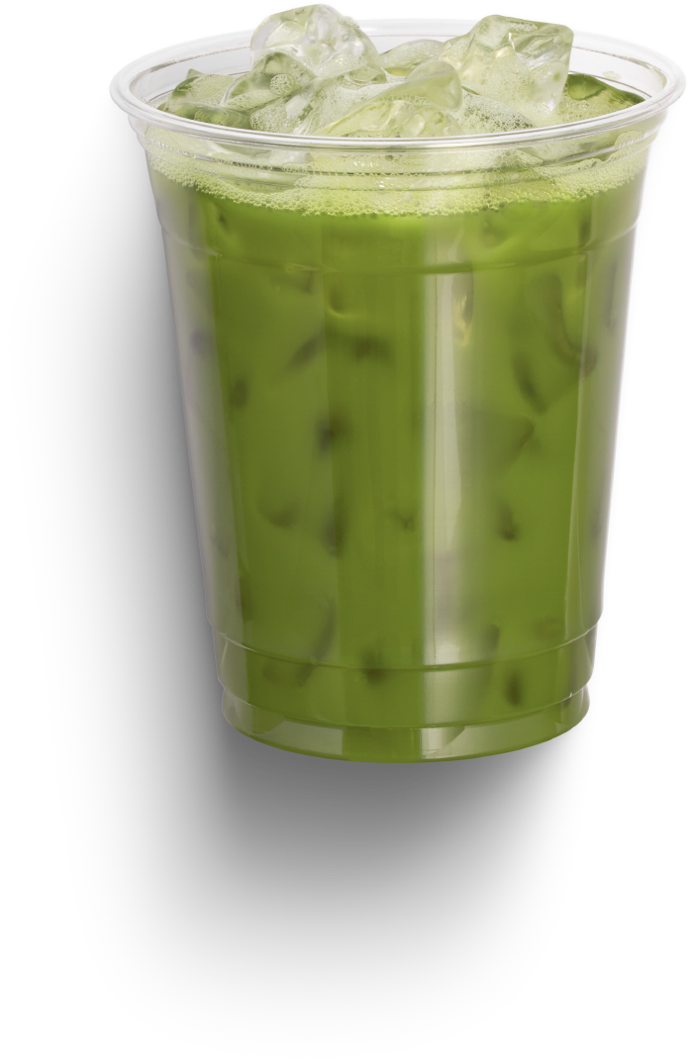
About the Project
TD MATCHA is a store where we sell really good matcha! We get the best matcha leaves, turn them into yummy powders, and share them with everyone. Our goal is to help people enjoy healthy drinks.

Slide 3
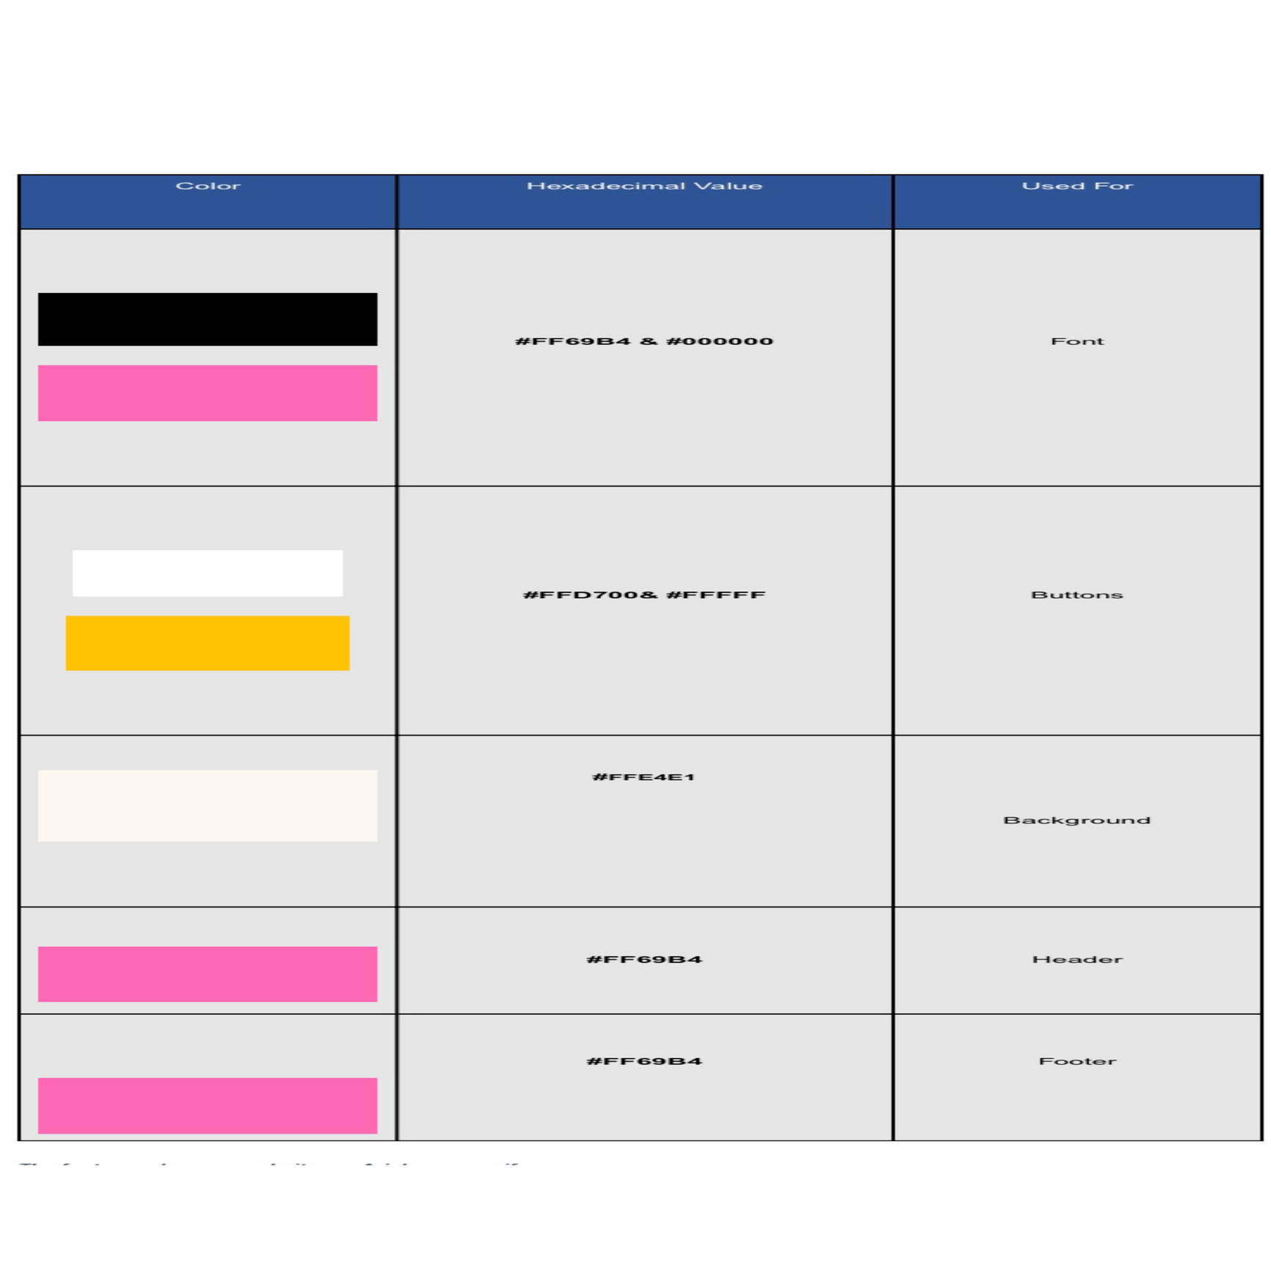
OUR SCHEME

Slide 4
FONT USED
THE FONTS MAINLY USED ARE: ARIAL, SANS-SERIF

Slide 5

INDEX.HTML
CART.HTML
ABOUTUS.HTML
PRODUCTS.HTML
SMALL MATCHA
MEDUIM MATCHA
LARGE MATCHA

Slide 6
PAGES
HOME
PRODUCTS
ABOUT US
CONTACT US
CART
EACH PAGE HAS A HEADER WITH LINKS TO ALL SECTIONS, A SEARCH BAR, AND A CURRENCY OPTION, ALONG WITH A FOOTER CONTAINING CONTACT INFORMATION LIKE GITHUB AND GMAIL.

Slide 7
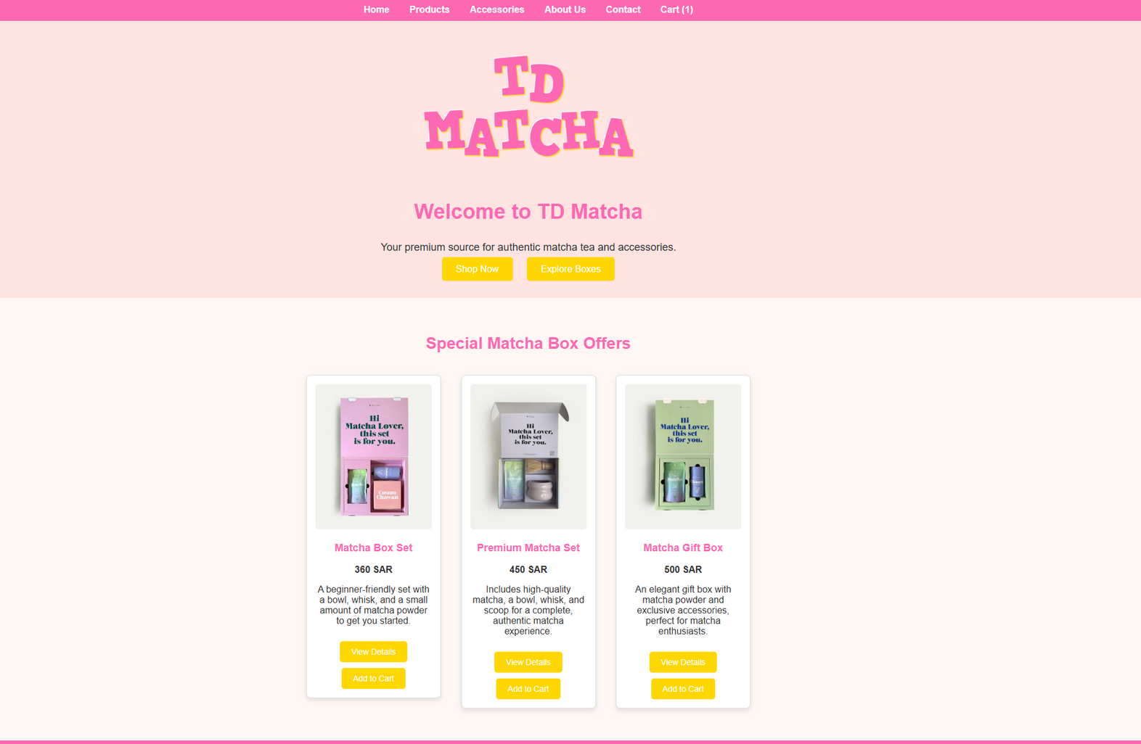
HOME PAGE

Slide 8
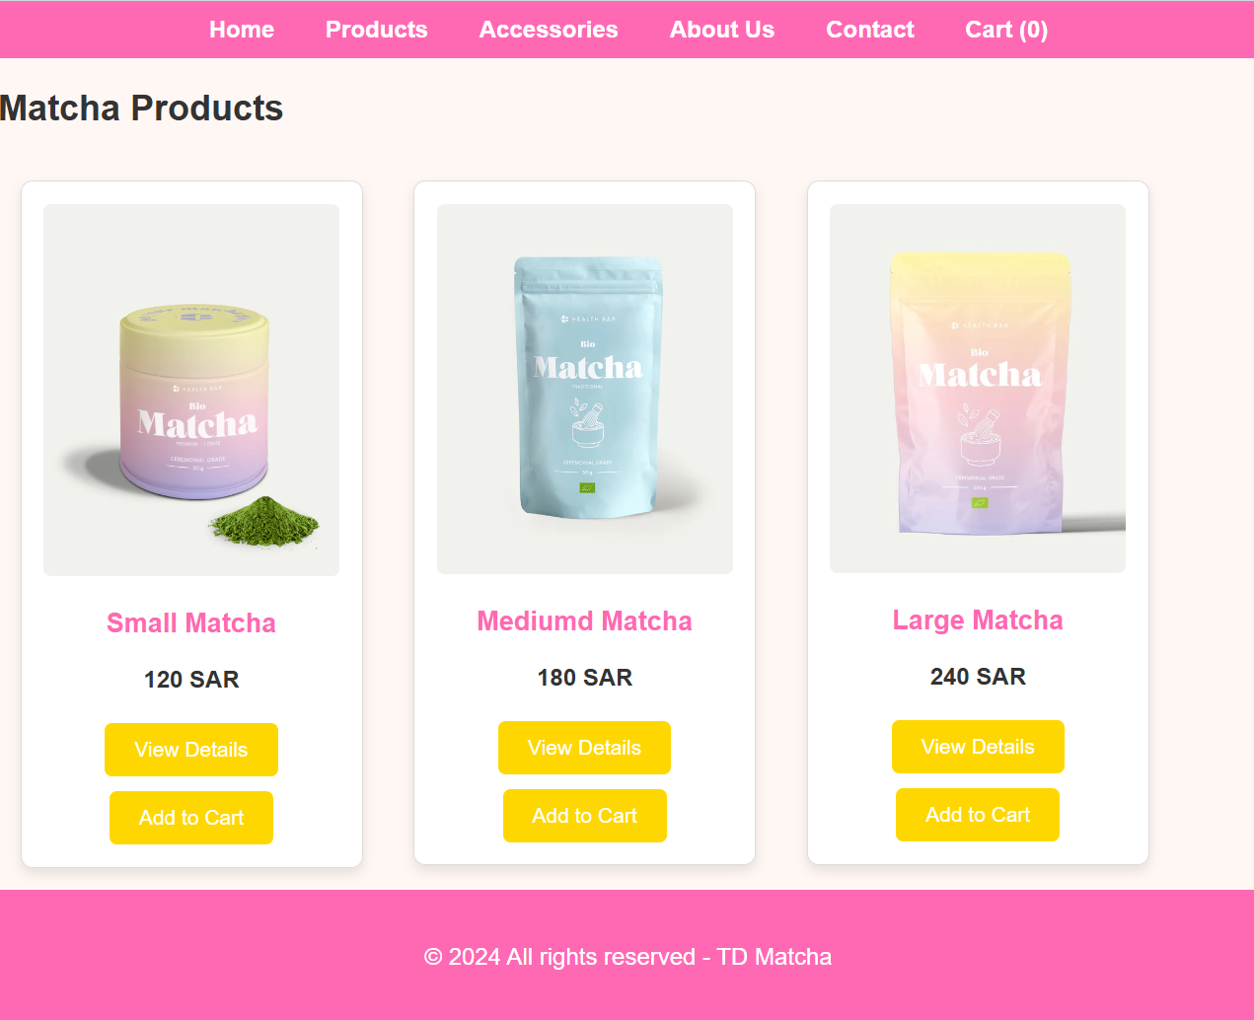
PRODUCTS

Slide 9
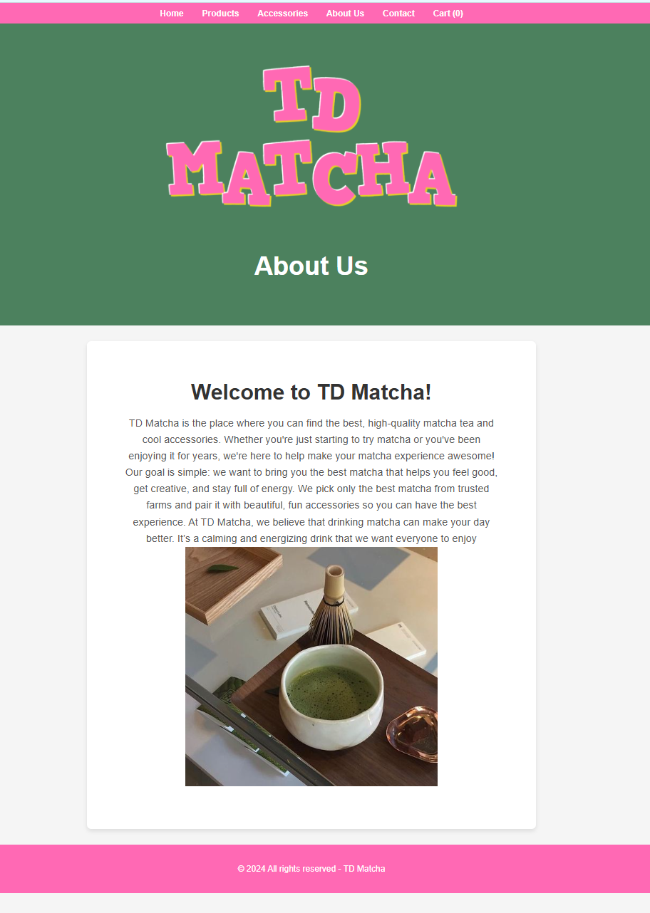
ABOUT US PAGE

Slide 10
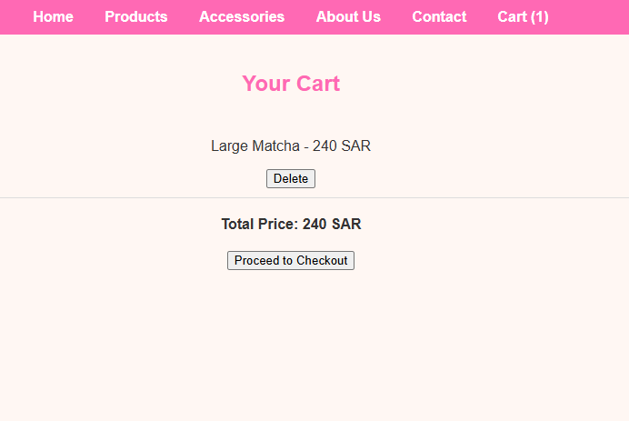
CART PAGE

Slide 11
JA
JAVASCRIPT
<SCRIPT
SRC="../SRC/JS/JAVASCRIPT.JS"><
/SCRIPT>
CSS
<LINK REL="STYLESHEET" HREF="../SRC/CSS/STYLES.CSS">
HEADER/NAVBAR +PRODUCTS CSS
<LINK REL="STYLESHEET" HREF="../SRC/CSS/INDEX.CSS"> HOME PAGE CSS
<LINK REL="STYLESHEET" HREF="../SRC/CSS/FOOTER.CSS"> FOOTER <LINK REL="STYLESHEET" HREF="../SRC/CSS/ABTME.CSS"> ABOUT US CSS
<LINK REL="STYLESHEET" HREF="../SRC/CSS/CART.CSS"> CART CSS

Slide 12

THANK YOU

